Slide 1
A PLAIN-LANGUAGE GUIDE TO WHAT WENT WRONG
FLOCK SAFETY
in Trempealeau County & Galesville
Six broken laws. One county. One city. License plate cameras nobody voted for.
Andy Parrish
Trempealeau County Supervisor, District 2 (Seat 2)
Free Act

Slide 2
WHAT THIS IS ABOUT
Flock Safety cameras were bought, set up, and turned on in Trempealeau County and the City of Galesville without the votes and approvals that Wisconsin law requires.
1
The Sheriff signed a contract he had no power to sign
2
The County Board never voted to approve it
3
173 outside police agencies got data with zero written agreements
TREMPEALEAU COUNTY
TREMPEALEAU COUNTY
TREMPEALEAU COUNTY
4
Galesville's Common Council never voted on the cameras
5
The Mayor approved cameras alone, without the Council
6
Cameras keep running after a formal legal complaint was filed
CITY OF GALESVILLE
CITY OF GALESVILLE
COUNTY & CITY
Andy Parrish · Trempealeau County Supervisor, District 2
Source documents on file. Open Records Act compliant.

Slide 3
COUNTY VIOLATION
THE SHERIFF SIGNED A CONTRACT HE WAS NOT ALLOWED TO SIGN
1
In Wisconsin, only the County Board can sign contracts that spend taxpayer money. The Sheriff cannot do it on his own.
WHAT THE LAW SAYS
Wisconsin Attorney General Opinion (1989) · Wis. Statutes 59.07 and 59.27
"A county officer cannot sign contracts unless the law clearly gives them that power, or unless it's obviously part of the job they were hired to do."
WHAT HAPPENED
On November 15, 2024, Sheriff Brett Semingson signed a 24-month, $20,650 contract with Flock Safety by himself.
State law lists exactly what a sheriff is allowed to do. Buying surveillance equipment is not on that list.
State law gives the power to spend county money to the County Board — the elected supervisors — not to the Sheriff.
A 2009 Wisconsin court ruling (Brown County) confirmed it: sheriffs handle traditional law enforcement duties only. Purchasing equipment is a budget matter, and budget decisions belong to the Board.
1 OF 3
Andy Parrish · Trempealeau County Supervisor, District 2
Source documents on file. Open Records Act compliant.

Slide 4
COUNTY VIOLATION
THE COUNTY BOARD NEVER GOT A VOTE
2
The contract spent $20,650 of public money. The elected County Board was never asked to vote yes or no.
WHAT THE LAW SAYS · Wis. Statute 59.51(2)
The County Board is in charge of running the county's business. The Board has the power to tax, to set aside money, and to spend money to carry out its work. That power belongs to the Board — to no one else.
WHAT HAPPENED
The County Board has never voted on the Flock contract — not before it was signed, not after, not ever.
In August 2024, the Sheriff sent a budget memo asking for $12,750 for cameras — tucked quietly into the investigator budget line, not flagged as its own decision.
On September 11, 2024, the Sheriff talked about cameras at a committee meeting. But a committee chat is not a Board vote. Only the full Board can approve spending.
State law is clear: county powers "can only be exercised by the county board." That means a real vote on a real motion — not a memo, not a hallway conversation.
2 OF 3
Andy Parrish · Trempealeau County Supervisor, District 2
Source documents on file. Open Records Act compliant.

Slide 5
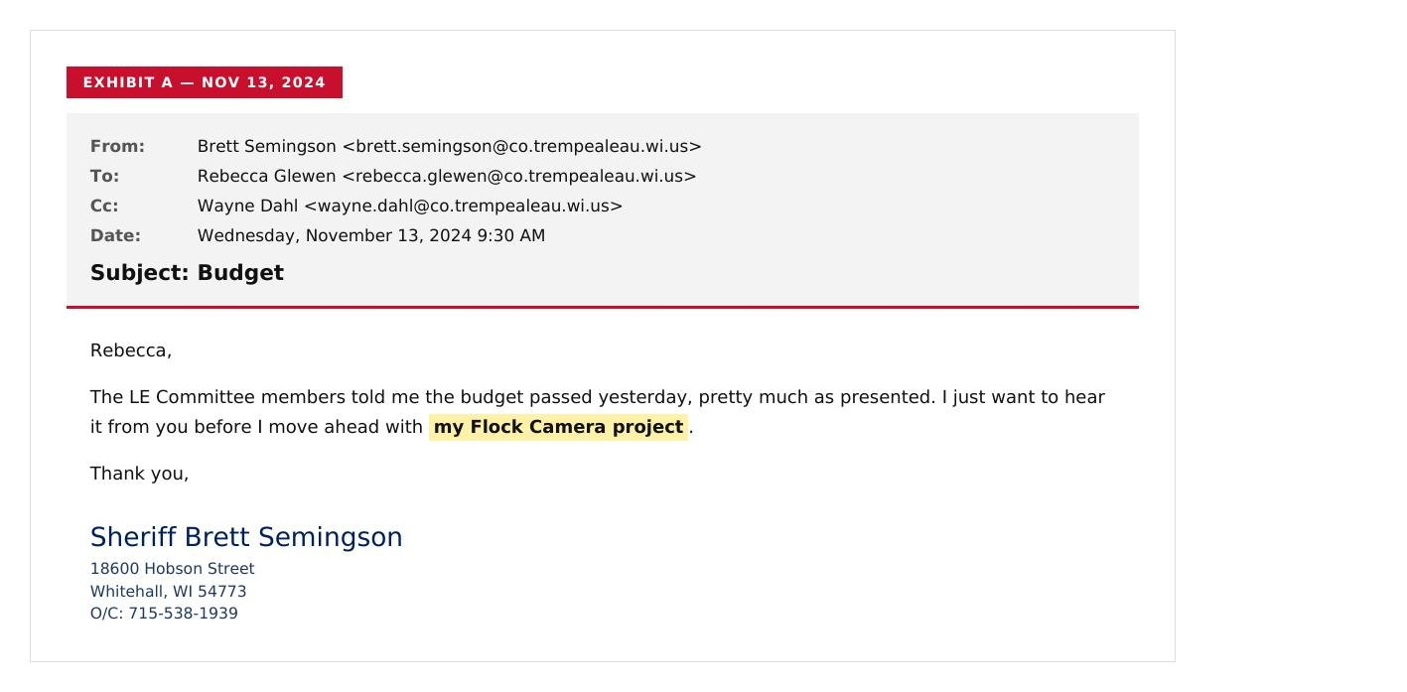
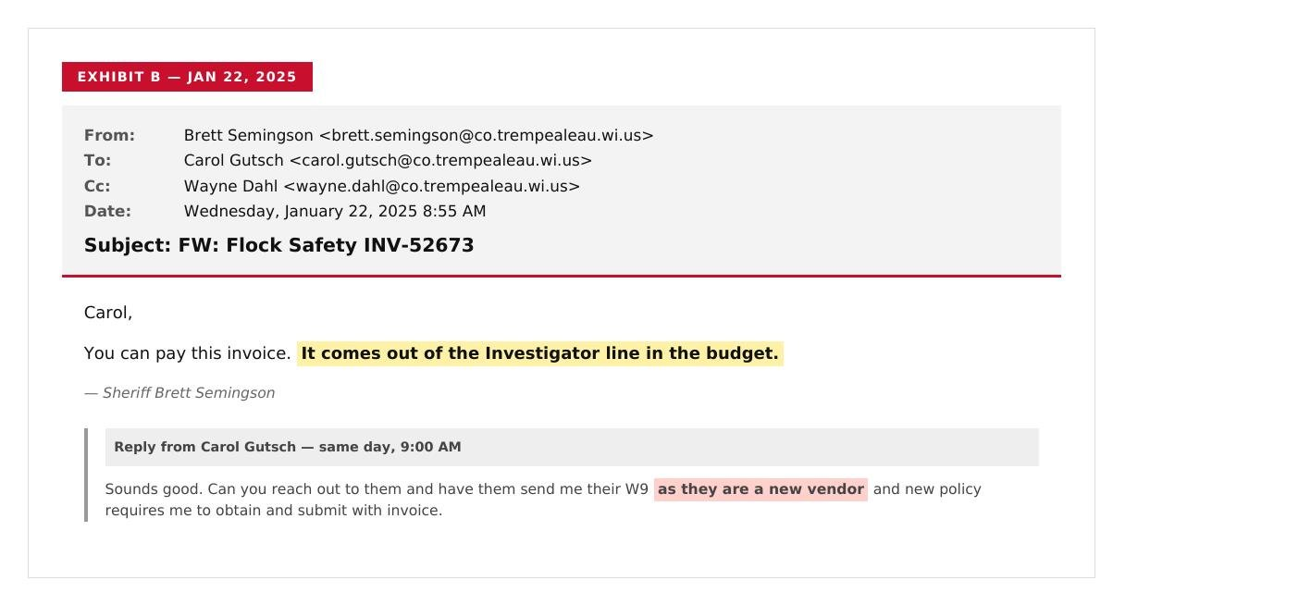
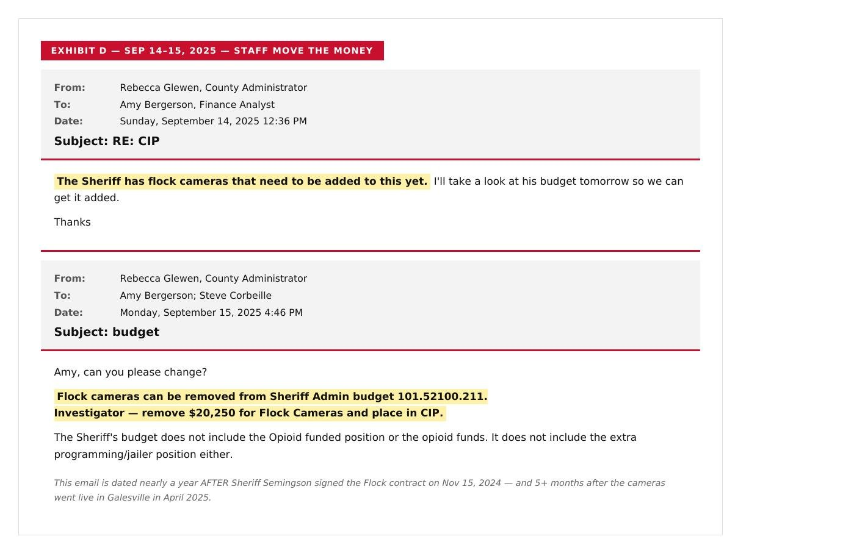
COUNTY
EVIDENCE
THE BUDGET MANIPULATION — IN THEIR OWN WORDS
Buried in the budget. Back-dated. Then quietly moved.
A
NOV 13, 2024 · 2 DAYS BEFORE SIGNING
JAN 22, 2025 · "INVESTIGATOR LINE"
SEP 15, 2025 · MOVED TO CIP
The Sheriff called it "my Flock Camera project." It was paid from "Investigator." A year later, staff moved $20,250 to clean up the trail.
Andy Parrish · Trempealeau County Supervisor, District 2
Source documents on file. Open Records Act compliant.

Slide 6
COUNTY
EVIDENCE
WHAT IS CIP — AND WHY DID STAFF MOVE THE MONEY THERE A YEAR LATE?
You can't approve a contract after it's already signed.
E
WHAT IS CIP?
WHAT STAFF DID ON SEPTEMBER 15, 2025
CIP stands for Capital Improvement Plan. It's a multi-year list of a county's BIG purchases — buildings, vehicles, equipment that lasts for years.
FROM
TO
Investigator
CIP
By Wisconsin law, the County Board approves the CIP IN ADVANCE, in public, with a public hearing — usually months before the contract is signed.
operating budget line
Capital Improvement Plan
$20,250 · for Flock Cameras
The 2025 CIP was adopted in 2024. Flock cameras were NOT in it.
WHY THIS MATTERS
Moving money in the books later does NOT create Board approval that never happened.
Staff cannot unilaterally reclassify spending for items the Board never voted on. That requires a Board resolution. There isn't one.
The move itself is an admission: the original budgeting was wrong.
You can move the money. You cannot move the date. The contract was signed Nov 15, 2024 — without a Board vote, without a CIP listing, without public notice.
Andy Parrish · Trempealeau County Supervisor, District 2
Source: Trempealeau County emails, Sep 14–15, 2025 · Open Records Act compliant.

Slide 7
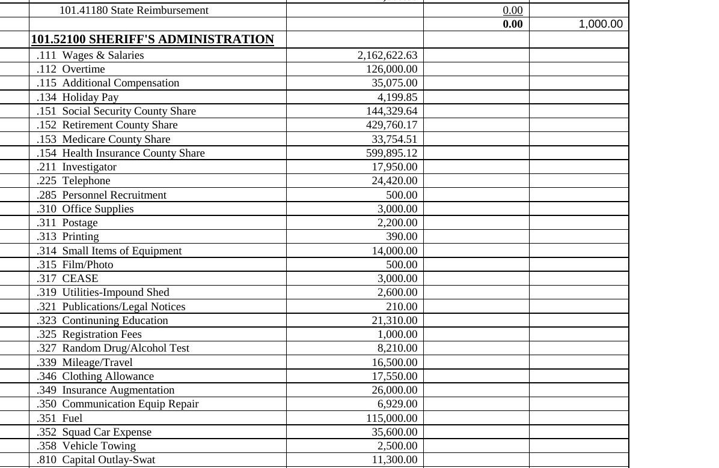
COUNTY
EVIDENCE
THE PUBLIC 2025 BUDGET — WHAT VOTERS SAW
"Investigator" $17,950. Zero mention of Flock, ALPR, or surveillance.
B
WHAT YOU CAN SEE
101.52100
Sheriff's Administration
.211 Investigator
$17,950 — the line the Sheriff later confirmed pays for Flock
.810 Capital Outlay
Three lines listed: SWAT, Radar/Video Camera, Vest. No Flock line.
Search the entire 1,894-line budget book: not one line says "Flock," "ALPR," "license plate reader," or "surveillance." The Board approved an "Investigator" line — not a 24-month surveillance contract.
Andy Parrish · Trempealeau County Supervisor, District 2
Source documents on file. Open Records Act compliant.

Slide 8
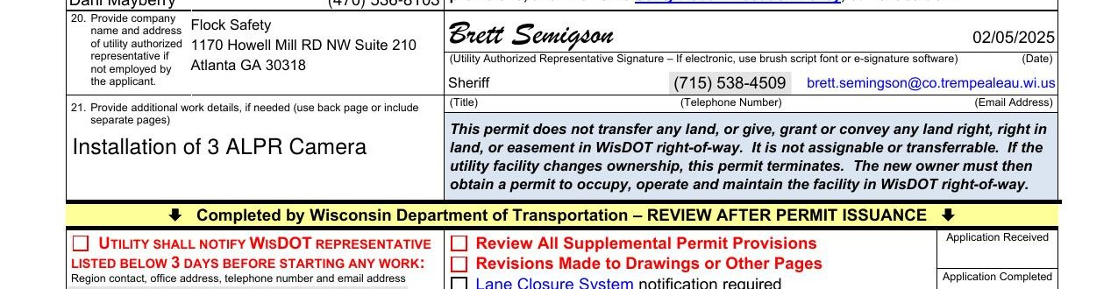
COUNTY
EVIDENCE
THE WISDOT PERMIT — WHO SIGNED FOR WHOM?
The Sheriff signed as the agent for a private Atlanta corporation.
C
WisDOT Form DT1553, dated February 5, 2025 · Wis. Stat. §§ 66.0831, 86.07, 86.16
Field 20: "Flock Safety, 1170 Howell Mill RD NW Suite 210, Atlanta GA 30318" — listed as the utility owner.
Signature: Brett Semingson signs as the "Utility Authorized Representative" for Flock Safety. Title: Sheriff.
The Flock contract was already 82 days old when this state right-of-way permit was finally requested.
Andy Parrish · Trempealeau County Supervisor, District 2
Source documents on file. Open Records Act compliant.

Slide 9
COUNTY VIOLATION
173 OUTSIDE POLICE AGENCIES — ZERO WRITTEN AGREEMENTS
3
Trempealeau County shares Flock camera data with 173 other police agencies. The law requires a signed agreement for each one. There are none.
WHAT THE LAW SAYS · Wis. Statute 66.0301(2)
When one local government shares services or powers with another, the elected leaders of BOTH governments have to approve the deal in writing. No vote, no deal.
173
0
outside police agencies given access to Trempealeau County's Flock data
signed agreements on file (the law requires one for each)
Includes agencies in other states
Confirmed in writing by the County's own lawyer in February 2026
3 OF 3
Andy Parrish · Trempealeau County Supervisor, District 2
Source documents on file. Open Records Act compliant.

Slide 10
GALESVILLE VIOLATION
NO PUBLIC NOTICE. NO PUBLIC VOTE.
1
Galesville residents never got a heads-up. The Common Council never put cameras on a meeting agenda before they went live.
WHAT THE LAW SAYS · Wis. Open Meetings Law (Statutes 19.83 & 19.84)
Before any government meeting, the public must be told ahead of time: when it is, where it is, and what will be discussed. The notice has to be specific enough that regular people and reporters can actually understand what's on the agenda.
WHAT HAPPENED IN GALESVILLE
No Galesville Common Council agenda — at any point before April 2025 — listed Flock cameras as an item for discussion or vote.
The cameras went live in Galesville in April 2025 — and the Council still hadn't voted on them.
On February 4, 2025, Mayor Thatcher sent a one-paragraph email saying the cameras were OK. An email is not a meeting. The public was never told.
Wisconsin law (Statute 19.81) starts with a promise: the people have the right to "the fullest and most complete information" about what their government is doing. That promise was broken here.
1 OF 3
Andy Parrish · Trempealeau County Supervisor, District 2
Source documents on file. Open Records Act compliant.

Slide 11
GALESVILLE VIOLATION
THE MAYOR APPROVED THE CAMERAS ALONE
2
A mayor in Wisconsin cannot bind a city to a deal by himself. That power belongs to the elected Common Council.
WHAT THE MAYOR CLAIMED · Galesville City Code Sec. 2-2-3(b)(1)
Mayor Thatcher pointed to a city rule that says he "enforces" city laws. Based on that one line, he decided he could put cameras on city property by himself — without ever asking the Common Council.
Even the City Attorney admitted in writing: he and the County's lawyer "were unable to determine what intergovernmental cooperation is defined as under the law." If the lawyers don't know, neither did the Mayor.
WHY THE MAYOR WAS WRONG
To sign a contract for the city, the law has to clearly and specifically give the mayor that power in writing. A vague rule about "enforcing laws" is not the same as a power to sign contracts.
The Common Council later held a vote on whether to remove a camera (it failed 3-2). If the Mayor really had the only say, that vote could not have happened. The Council's own action shows the Council — not the Mayor — is in charge.
And a vote NOT to remove something is not the same as a vote TO approve it. The law requires a clear "yes" vote from the Council. That never happened.
Bottom line: state law (Statute 66.0301) requires an active "yes" vote from the city's elected body. Silence, an email, or a failed removal motion do not count.
2 OF 3
Andy Parrish · Trempealeau County Supervisor, District 2
Source documents on file. Open Records Act compliant.

Slide 12
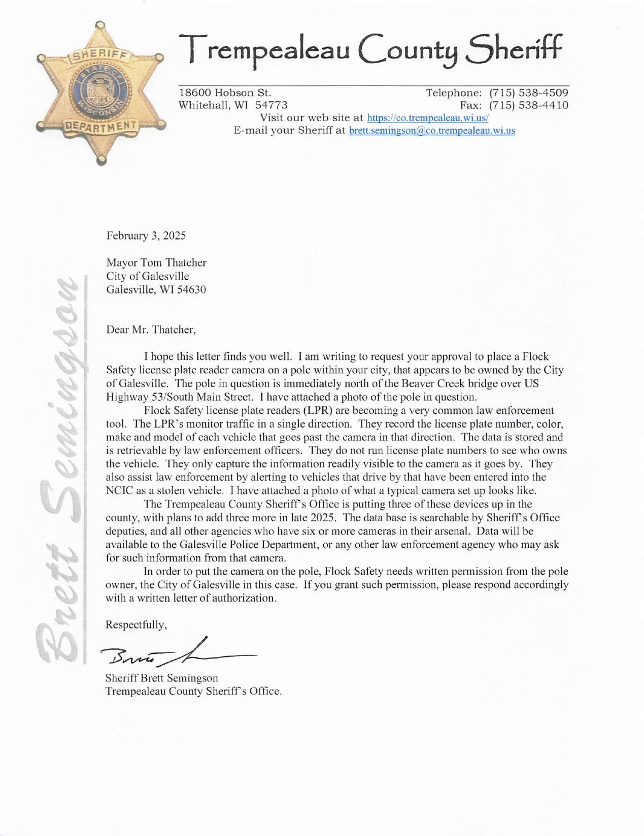
GALESVILLE
EVIDENCE
THE SHERIFF'S LETTER TO MAYOR THATCHER
The Sheriff asked the Mayor for written permission — on Flock's behalf.
D
DATED FEBRUARY 3, 2025 · ON SHERIFF'S LETTERHEAD
"In order to put the camera on the pole, Flock Safety needs written permission from the pole owner, the City of Galesville in this case. If you grant such permission, please respond accordingly with a written letter of authorization."
WHY THIS LETTER MATTERS
The Sheriff says FLOCK SAFETY — a private company — needs the permission. Not the County. The Sheriff is acting as Flock's agent.
Granting a private vendor occupancy of public property requires a Common Council vote, not a one-paragraph email from the Mayor.
This letter was sent nearly 3 months AFTER the Sheriff already signed the contract on Nov 15, 2024.
Andy Parrish · Trempealeau County Supervisor, District 2
Source documents on file. Open Records Act compliant.

Slide 13
COUNTY & CITY
THE CAMERAS KEEP RUNNING — AFTER A WRITTEN LEGAL COMPLAINT
3
The County and the City were both told, in writing, that the cameras were installed without proper approval. The cameras are still on.
WHY THIS MATTERS · Wisconsin Constitution, Article I, Section 11
"The right of the people to be secure in their persons, houses, papers, and effects against unreasonable searches and seizures shall not be violated."
A surveillance system that was never legally approved is not a legal search. Every license plate it scans raises that question.
WHO WAS TOLD, AND WHEN
Feb 2, 2026 — District Attorney John Sacia was notified in writing.
Feb 13, 2026 — A formal complaint with 8 supporting documents was filed with the DA.
Feb 17, 2026 — The County's own lawyer confirmed in writing: there are zero signed agreements for all 173 outside agencies.
Mar 9, 2026 — A formal Notice of Claim was delivered to the City of Galesville — the first step required by state law before suing a city.
May 4, 2026 — Galesville officially rejected the claim. The cameras are still running today.
3 OF 3
Andy Parrish · Trempealeau County Supervisor, District 2
Source documents on file. Open Records Act compliant.

Slide 14
IN THEIR OWN WORDS
What the County's two top lawyers actually said when asked to step in.
District Attorney John Sacia · Feb 19, 2026
"From my perspective, the concerns you present regarding Flock camera usage and the agreements that govern them are more of a corporation counsel / municipal attorney issue than a DA issue. ...it's not my position to advise the county board or a city's mayor on the soundness of whatever agreement put the camera in place."
County Lawyer Susan Fisher · Mar 9, 2026 (after 21 days of silence)
"Through this position, my client is the County as a whole, and I may not provide legal advice... to any other person(s). ...I am not a judicial officer — no formal legal determination may be made here directly... the City of Galesville may be better suited to discuss their own city-specific rules."
Translation: both the DA and the County's lawyer pointed somewhere else. Nobody acted. The cameras are still online.
Andy Parrish · Trempealeau County Supervisor, District 2
Source documents on file. Open Records Act compliant.

Slide 15
THE FULL TIMELINE
Every step. On the record.
COUNTY
Aug 2024
Sheriff starts looking into Flock cameras
PARRISH
Feb 13, 2026
Formal complaint filed with DA, plus 8 documents
COUNTY
Sep 11, 2024
Sheriff brings cameras up at committee meeting
PARRISH
Feb 17, 2026
County confirms in writing: zero agreements for 173 agencies
COUNTY
Nov 15, 2024
Sheriff signs $20,650 contract — no Board vote
DA
Feb 19, 2026
DA Sacia: "not my position to advise"
CITY
Feb 4, 2025
Mayor approves cameras by email, alone
PARRISH
Feb 19, 2026
Parrish formally asks County lawyer for a ruling
CITY
Apr 2025
Cameras go live in Galesville
COUNSEL
Mar 9, 2026
Fisher (after 21 days): can't give a formal opinion
PARRISH
Feb 2, 2026
Andy Parrish first contacts DA Sacia
PARRISH
Mar 9, 2026
Legal claim served on Galesville City Clerk
PARRISH
Feb 6, 2026
Open records request sent to County lawyer
CITY
May 4, 2026
Galesville officially rejects the claim — cameras stay on
COUNTY
CITY
PARRISH
DA
COUNSEL
Andy Parrish · Trempealeau County Supervisor, District 2
Source documents on file. Open Records Act compliant.

Slide 16
QUICK SUMMARY
Three problems with the County. Three problems with the City. Cameras still running.
1
The Sheriff signed a contract he had no power to sign
TREMPEALEAU COUNTY
2
The County Board never voted on the purchase
TREMPEALEAU COUNTY
3
173 outside police agencies got data — zero signed agreements
TREMPEALEAU COUNTY
4
No public notice — Common Council never put cameras on an agenda
CITY OF GALESVILLE
5
The Mayor had no power to approve cameras by himself
CITY OF GALESVILLE
6
Cameras keep running after formal written complaint
COUNTY & CITY
Andy Parrish · Trempealeau County Supervisor, District 2
Source documents on file. Open Records Act compliant.

Slide 17
WHAT NEEDS TO HAPPEN NOW
Three things that must happen — in the County and in Galesville.
1
Turn off the cameras until they're properly approved.
Every Flock camera in Trempealeau County and Galesville should be deactivated and covered until: the County Board has voted to approve the contract, the Galesville Common Council has voted to approve the cameras, signed agreements are on file for every outside agency that gets data, and the public has been given proper notice.
2
Bring in an outside lawyer to review everything.
The District Attorney said it's not his job. The County's own lawyer said she can't give a formal opinion. With both of them out, an outside special lawyer needs to step in and decide what is legal and what is not — and what happens to the data already collected.
3
Pass a new rule: surveillance equipment needs a real public vote.
The County and Galesville should each pass a law: any new surveillance system needs a two-thirds vote of the elected body and a public hearing first. What happened with Flock cannot happen again. Surveillance is a big decision — it deserves a real, open debate, not a quiet line in a budget memo.
"Privacy is a right. The rule of law is not optional."

